Slide 1
Modern AI: Applications and Machine Learning Workflow

Slide 2
Learning Goals
In this section, we will cover:
- Applications
- Background and tools used in this course
- Machine Learning workflow
- Machine Learning vocabulary

Slide 3
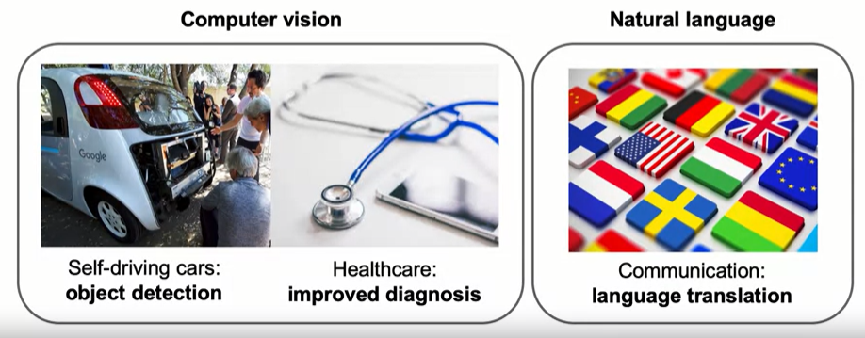
Modern AI (2012 - ?): Impact

Slide 4
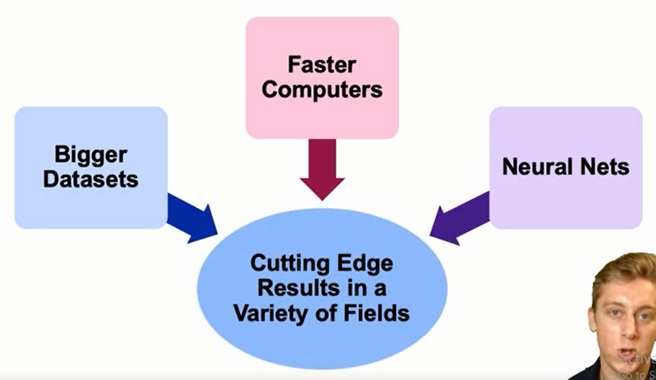
How Is This Era of AI Different?

Slide 5
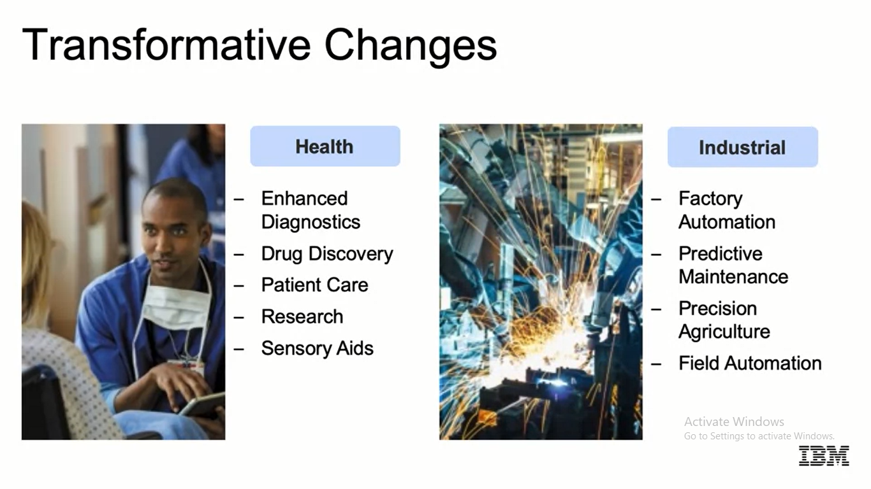
Transformative Changes
Health
Industrial
- Enhanced
Diagnostics
- Drug Discovery
- Patient Care
- Research
- Sensory Aids
- Factory
Automation
- Predictive
Maintenance
- Precision
Agriculture
- Field Automation

Slide 6
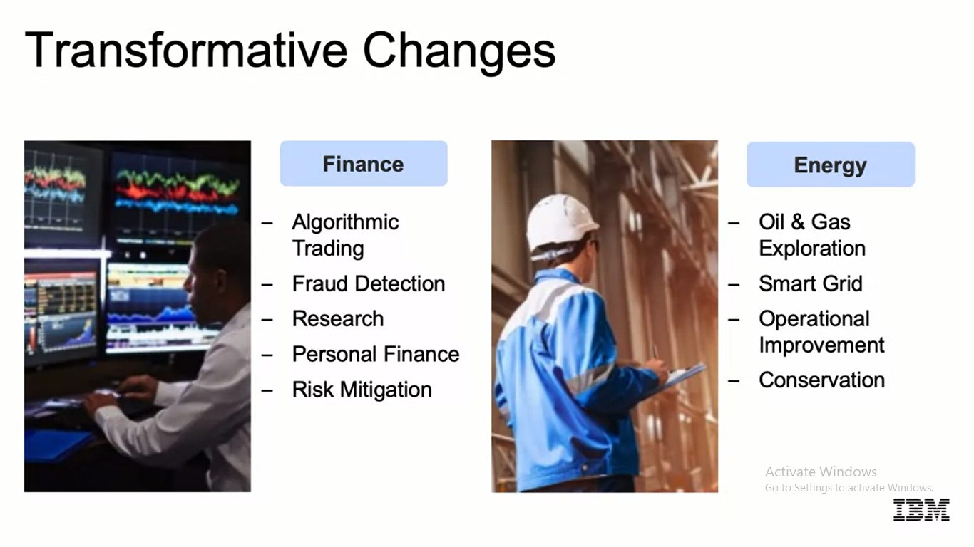
Transformative Changes
Finance
Energy
- Algorithmic
Trading
- Fraud Detection
- Research
- Personal Finance
- Risk Mitigation
- Oil & Gas
Exploration
- Smart Grid
- Operational
Improvement
- Conservation

Slide 7
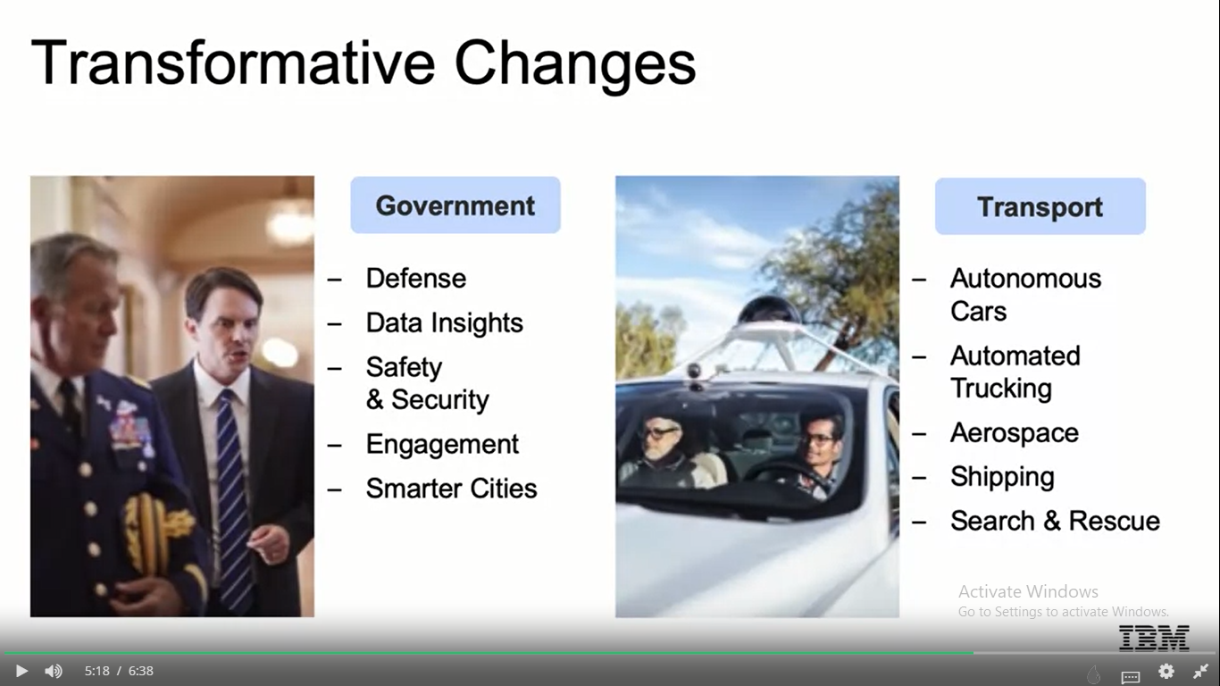
Transformative Changes
Government
Transport
- Defense
- Data Insights
- Safety
& Security
- Engagement
- Smarter Cities
- Autonomous
Cars
- Automated
Trucking
- Aerospace
- Shipping
- Search & Rescue

Slide 8
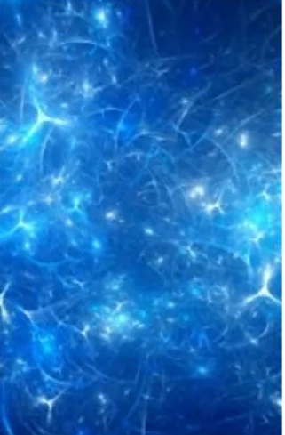
Transformative Changes
And More!
- Advertising
- Education
- Gaming
- Professional
& IT Services
- Telco / Media
- Sports

Slide 9
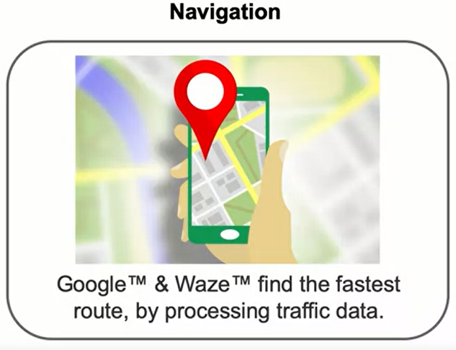
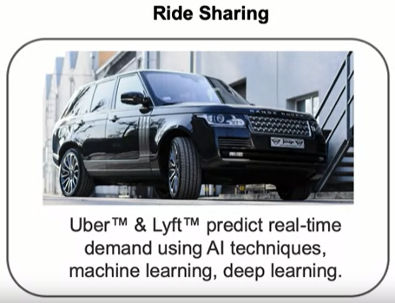
AI Omnipresence in Transportation

Slide 10
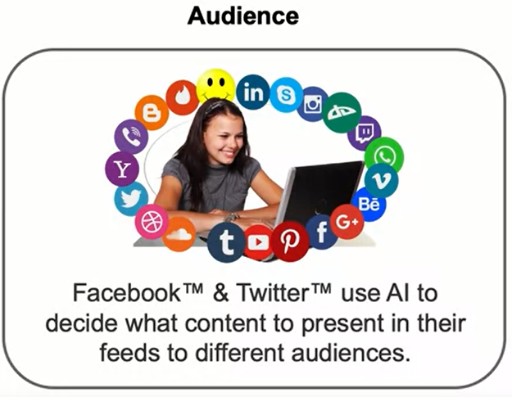
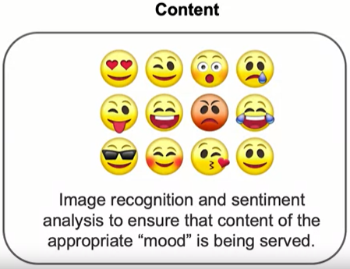
AI Omnipresence in Social Media

Slide 11
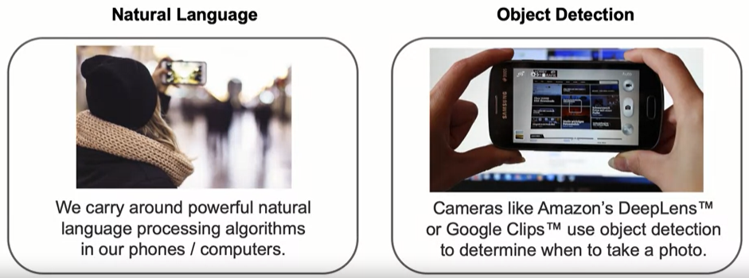
AI Omnipresence in Daily Life

Slide 12
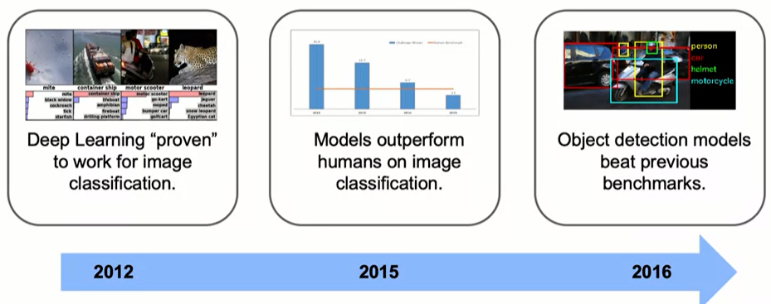
Latest Developments: Computer Vision

Slide 13
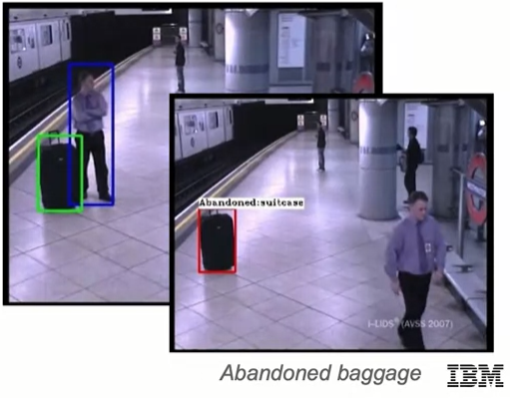
Example: Abandoned Baggage Detection
We can automatically detect when baggage has been left unattended, potentially saving lives.
This system relies on the breakthroughs we discussed:
- Cutting edge object detection.
- Fast hardware on which to train the model.

Slide 14
Background and Tools
Examples assume familiarity with:
- Python libraries (e.g. NumPy or Pandas), Jupyter Notebooks
- Basic statistics including probability, calculating moments, Bayes' Rule
Examples use iPython (via Jupyter Lab/Notebook), with the following Libraries:
- NumPy
- Pandas (We will usually read data into a Pandas DataFrame)
- Matplotlib
- Seaborn
- Scikit-Learn
- TensorFlow
- Keras

Slide 15
Machine Learning Workflow
Problem Statement
What problem are you trying to solve?
Data Collection
What data do you need to solve it?
Data Exploration & Preprocessing
How should you clean your data so your model can use it?
Modeling
Build a model to solve your problem?
Validation
Was the problem solved?
Decision Making & Deployment
Communicate to stakeholders or put into production?

Slide 16
Machine Learning Vocabulary
Target: category or value that we are trying to predict

Slide 17
Machine Learning Vocabulary
sepal length | sepal width | petal length | petal width | species
6.7 | 3.0 | 5.2 | 2.3 | virginica
6.4 | 2.8 | 5.6 | 2.1 | virginica
4.6 | 3.4 | 1.4 | 0.3 | setosa
6.9 | 3.1 | 4.9 | 1.5 | versicolor
4.4 | 2.9 | 1.4 | 0.2 | setosa
4.8 | 3.0 | 1.4 | 0.1 | setosa
5.9 | 3.0 | 5.1 | 1.8 | virginica
5.4 | 3.9 | 1.3 | 0.4 | setosa
4.9 | 3.0 | 1.4 | 0.2 | setosa
5.4 | 3.4 | 1.7 | 0.2 | setosa
Target

Slide 18
Machine Learning Vocabulary
Features: properties of the data used for prediction (explanatory variables)

Slide 19
Machine Learning Vocabulary
Features
sepal length | sepal width | petal length | petal width | species
6.7 | 3.0 | 5.2 | 2.3 | virginica
6.4 | 2.8 | 5.6 | 2.1 | virginica
4.6 | 3.4 | 1.4 | 0.3 | setosa
6.9 | 3.1 | 4.9 | 1.5 | versicolor
4.4 | 2.9 | 1.4 | 0.2 | setosa
4.8 | 3.0 | 1.4 | 0.1 | setosa
5.9 | 3.0 | 5.1 | 1.8 | virginica
5.4 | 3.9 | 1.3 | 0.4 | setosa
4.9 | 3.0 | 1.4 | 0.2 | setosa
5.4 | 3.4 | 1.7 | 0.2 | setosa

Slide 20
Machine Learning Vocabulary
Example: a single data point within the data (one row)

Slide 21
Machine Learning Vocabulary
sepal length | sepal width | petal length | petal width | species
6.7 | 3.0 | 5.2 | 2.3 | virginica
6.4 | 2.8 | 5.6 | 2.1 | virginica
4.6 | 3.4 | 1.4 | 0.3 | setosa
6.9 | 3.1 | 4.9 | 1.5 | versicolor
4.4 | 2.9 | 1.4 | 0.2 | setosa
4.8 | 3.0 | 1.4 | 0.1 | setosa
5.9 | 3.0 | 5.1 | 1.8 | virginica
5.4 | 3.9 | 1.3 | 0.4 | setosa
4.9 | 3.0 | 1.4 | 0.2 | setosa
5.4 | 3.4 | 1.7 | 0.2 | setosa
Observation / Example

Slide 22
Machine Learning Vocabulary
Label: the target value for a single data point

Slide 23
Machine Learning Vocabulary
sepal length | sepal width | petal length | petal width | species
6.7 | 3.0 | 5.2 | 2.3 | virginica
6.4 | 2.8 | 5.6 | 2.1 | virginica
4.6 | 3.4 | 1.4 | 0.3 | setosa
6.9 | 3.1 | 4.9 | 1.5 | versicolor
4.4 | 2.9 | 1.4 | 0.2 | setosa
4.8 | 3.0 | 1.4 | 0.1 | setosa
5.9 | 3.0 | 5.1 | 1.8 | virginica
5.4 | 3.9 | 1.3 | 0.4 | setosa
4.9 | 3.0 | 1.4 | 0.2 | setosa
5.4 | 3.4 | 1.7 | 0.2 | setosa
Label

Slide 24
Summary
Modern AI
Factors that have contributed to the current state of Machine Learning are: bigger data sets, faster computers, open source packages, and a wide range of neural network architectures.
Machine Learning Workflow
The machine learning workflow consists of:
Problem statement
Data collection
Data exploration and preprocessing
Modeling
Validation
Decision Making and Deployment

Slide 25
Summary
Summary of the common taxonomy for data in open source packages for Machine Learning:
target: category or value you are trying to predict
features: explanatory variables used for prediction
example: an observation or single data point within the data
label: the value of the target for a single data point

Slide 26
Learning Recap
In this section, we discussed:
- Applications
- Background and tools used in this course
- Machine Learning workflow
- Machine Learning vocabulary

